Slide 1
Presentation of ESL Apps
Based on the course:
Tech-Enhanced Creative Teaching Strategies: Merging Creativity and Technology 60 Lessons
Malta / February 2024
Cofunded by EU / Erasmus Plus
Project number: 2023-1-PL01-KA21-SCH-000117151

Slide 2
Blooket
Description: A game-based learning platform that makes education fun through interactive games. Features: Quizzes, competitive games, easy to use.
Link: Click here

Slide 3
Kahoot
Description: A platform that uses game-based learning to engage students in educational content. Features: Quizzes, surveys, interactive sessions.
Link: Click here

Slide 4
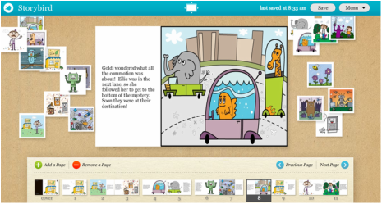
Storybird
Description: A platform for creating and sharing illustrated stories to improve language skills. Features: Story creation, illustration tools, sharing options.
Link: Click here

Slide 5
ToonyTools
Description: An educational tool that allows users to create cartoon stories to enhance language learning. Features: Cartoon creation, storytelling, creative tools.
Link: Click here

Slide 6
ChatGPT
Description: An AI language model that can assist with learning English through conversation and interaction. Features: Conversational AI, personalized learning, extensive knowledge base.
Link: Click here

Slide 7
Quizzizz
Description: A learning platform that uses quizzes and interactive lessons to make education engaging. Features: Quizzes, live sessions, reports.
Link: Click here

Slide 8
AirPano
Description: A platform offering 360-degree panoramas and virtual tours to learn English through exploration. Features: Virtual tours, interactive panoramas, educational content.
Link: Click here

Slide 9
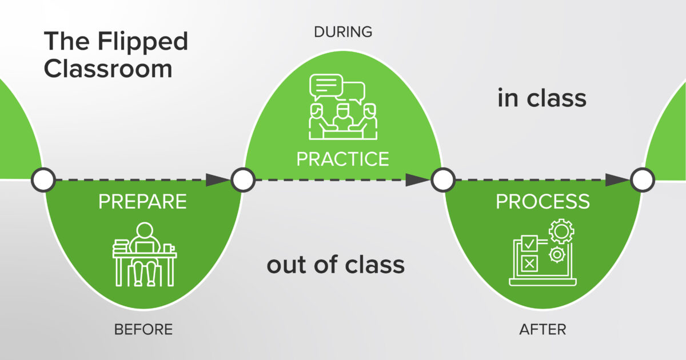
Flipped Classroom
Description: An educational approach where students learn content online by i.e. watching video lectures, usually at home, then they disscuss the topic at school. Features: Video lectures, interactive content, flexible learning.
Link: Click here

Slide 10
Mind Maps
Description: A visual tool for organizing and brainstorming ideas to aid in learning, memorizing and revision. Features: Visual organization, brainstorming tools, easy sharing.
Link: Click here

Slide 11
Slido
Description: An interactive Q&A and polling platform to engage students during lessons. Features: Live polls, Q&A sessions, surveys,quizzes.
Link: Click here

Slide 12
QR Code Generator
Description: A tool to create QR codes for easy access to educational content and resources. Features: QR code creation, easy sharing, customization.
Link: Click here

Slide 13
Klauzula :
The project has been funded with support of European Commission within Erasmus + Programme.
This publication reflects only the views of the author, and the Commission cannot be held responsible for any use which may be made of the information contained therein.
Projekt jest finansowany ze środków Komisji Europejskiej w ramach programu Erasmus+.
Niniejsza publikacja odzwierciedla jedynie stanowisko autorów i Komisja Europejska nie bierze odpowiedzialności za prezentowane treści.

Slide 14
Thank you for your attention ☺
Hope, you found at least some of those apps useful.
If not, don’t worry, there are lots of other ones to find and use.
Good luck☺
Kamila Ciba-Szwed

