Slide 1
Emilia-Romagna
2023-1-PL01-KA121-SCH-000117151
Marta Walska, Aleksandra Latra, Maciej Winiarski, Gaia Marchesini, Sarra Chaalali

Slide 2
General Information about Emilia-Romagna.
Emilia Romagna is an administrative region of Italy, which consists of two historical regions: Emilia and Romagna. Its capital is Bologna. It has an area of 22,446 km2 and a population of 4.4 million. It is regarded as one of the most wealthy regions in all of Europe thanks to its GDP(a monetary measure of market value), which is the third highest in Europe. The oldest university in the world lies here, The University of Bologna.

Slide 3
History of its name
The name Emilia-Romagna is a legacy of Ancient Rome. Emilia derives from the via Aemilia, the Roman road connecting Piacenza to Rimini, completed in 187 BC, and named after the consul Marcus Aemilius Lepidus. Romagna derives from Romània, the name of the Eastern Roman Empire applied to Ravenna by the Lombards when the western Empire had ceased to exist and Ravenna was an outpost of the east (540–751).

Slide 4
What is Emilia-Romagna famous for?
First of all: food. The Italians tend to claim that Emilia-Romagna has the best food in Italy. There are several dishes that are only properly made in this region: prosciutto di Parma, Parmigiano-Reggiano, balsamic vinegar of Modena and mortadella di Bologna.
The University of Bologna, which was mentioned earlier is also one of the things that tourists absolutely love. Emilia-Romagna is also famous for sports cars, especially Lamborghini, Ferrari, Maserati, Pagani.

Slide 5
Languages and dialects.
Apart from standard Italian, Emilian and Romagnolo, two closely related languages that are part of the Emiliano-Romagnolo language family, are the local languages of Emilia-Romagna.
They are Romance languages spoken in the region, in Northern Marche and other nearby areas such as parts of Massa-Carrara, Mantua, Pavia and Rovigo provinces and in San Marino. Piedmontese, Lombard, Ligurian and Venetian are also spoken in Emilia-Romagna.

Slide 6
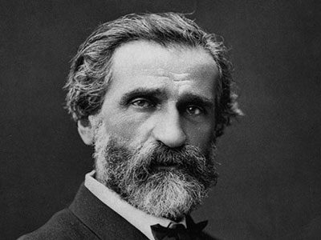
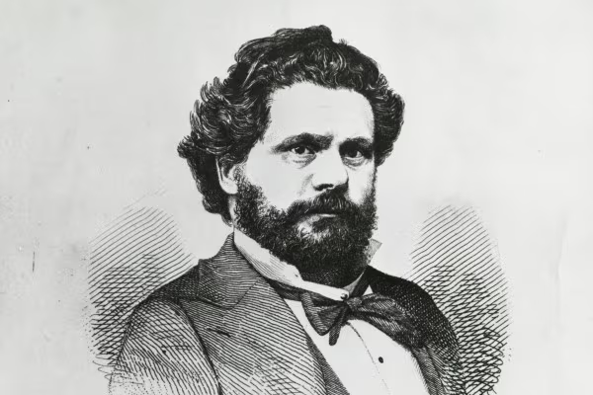
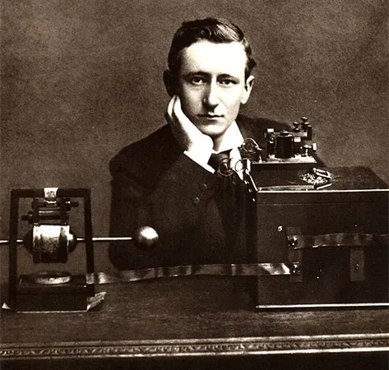
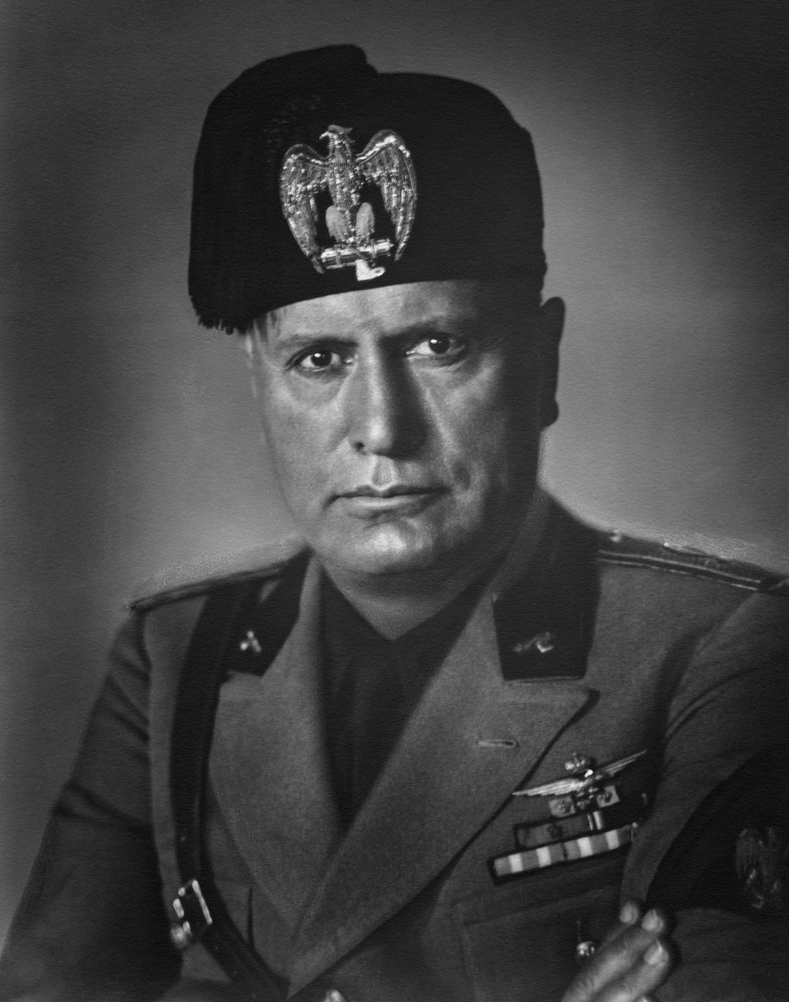
Famous people from Emilia-Romagna.
Giuseppe Verdi - a famous composer, being famous for his three operas, mainly Rigoletto Giosuè Carducci - often regarded as Italy’s national poet, won the nobel prize in 1906. Guglielmo Marconi - an inventor and a physicist. Marconi is known for his creation of a practical radio wave–based wireless telegraph system. Benito Mussolini - unfortunately, Mussolini was born in Predappio. He was a dictator.

Slide 7
The most attractive places in Emilia Romania
1.Labirinto della Masone 2.Casa Artusi Renesansowy 3.Pałac Il Palazzo dei 4.Diamanti Katedra w Modenie 5.Zamek w Bardi Bolonia 6.Tabiano Terme Bazylika 7.Świętego Witalisa Zamek 8.Castello di Rivalta Rimini 9.Santarcangelo di Romagna 10.Castello di Torrechiara 11.Parco Nazionale delle 12.Foreste Casentinesi Bobbio 13.Cascate del Bucamante

Slide 8
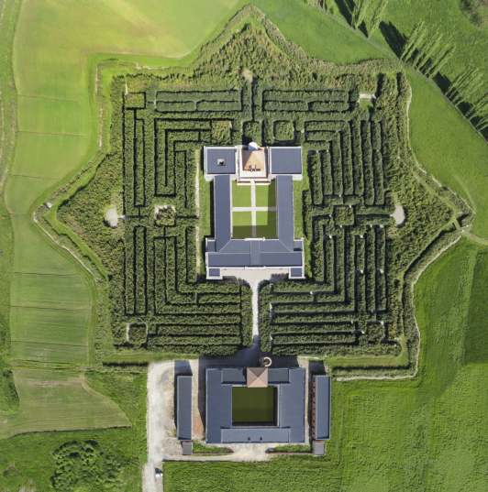
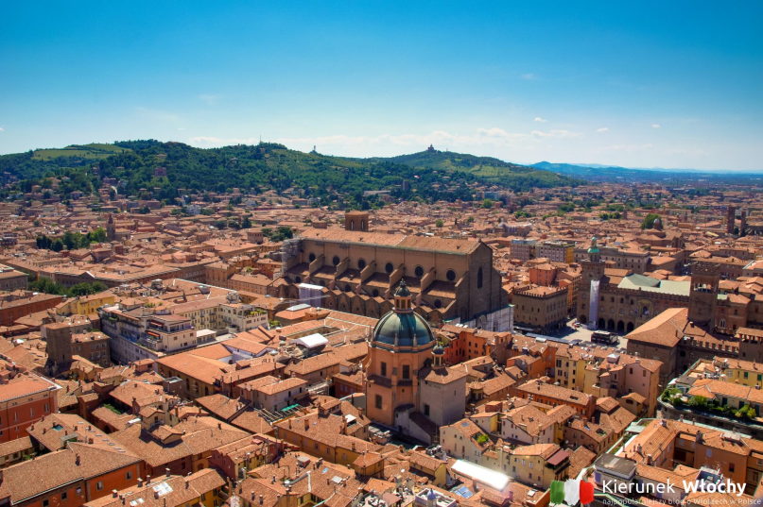
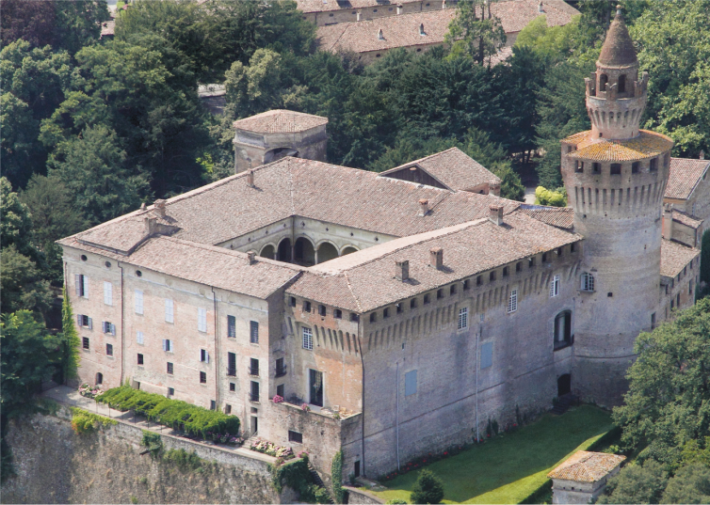
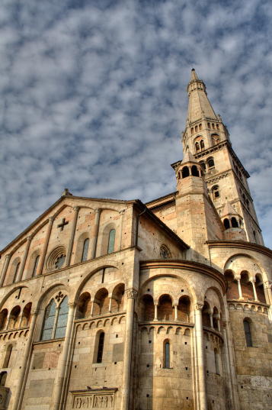
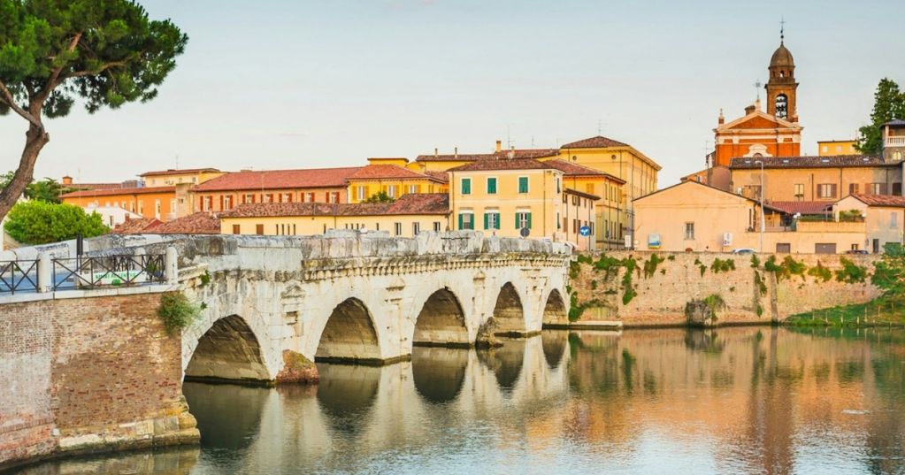
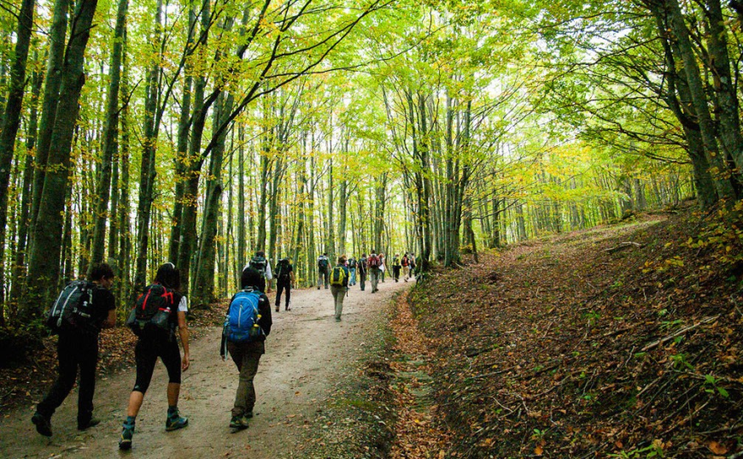
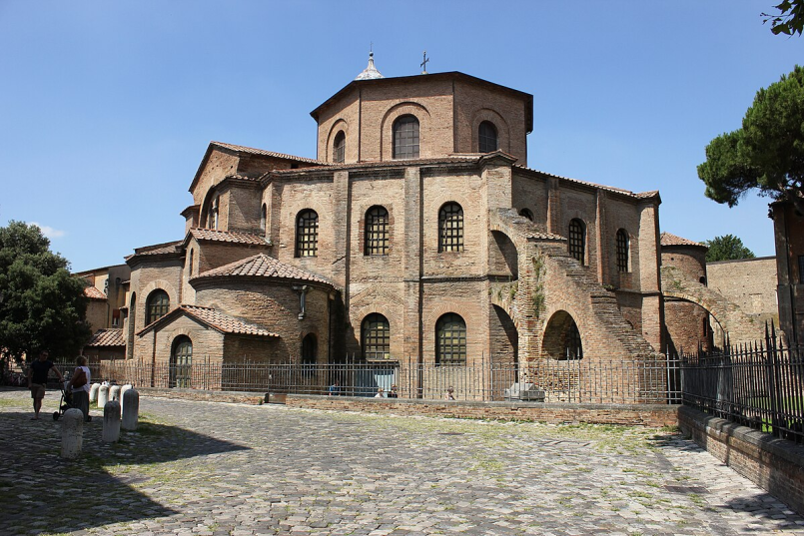
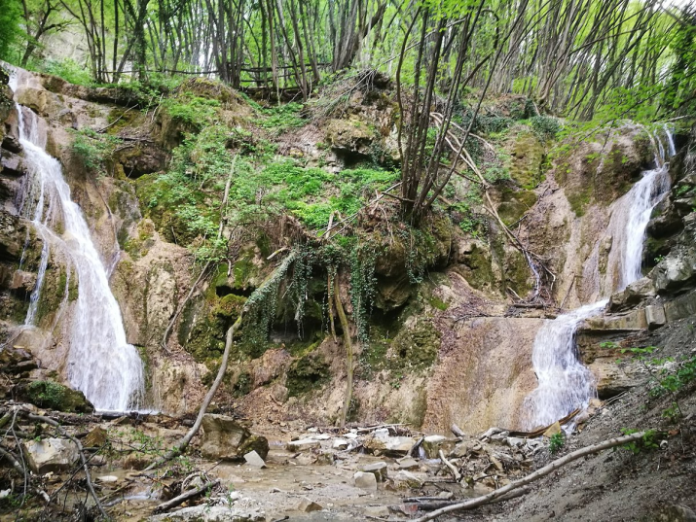
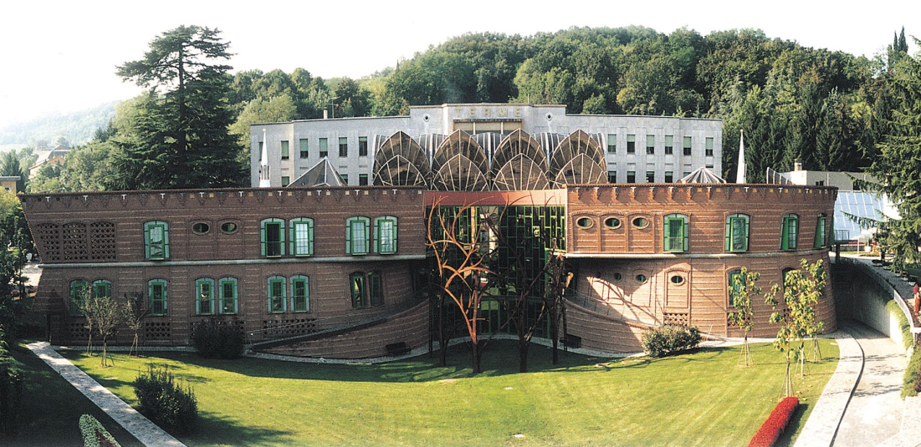

Slide 9
Thank you :D

Slide 10
The project has been funded with support of European Commission. This publication reflects only the views of the author, and the Commission cannot be held responsible for any use which may be made of the information contained therein.

